Slide 1

The Internet
Momentum Digital Basics

Slide 2

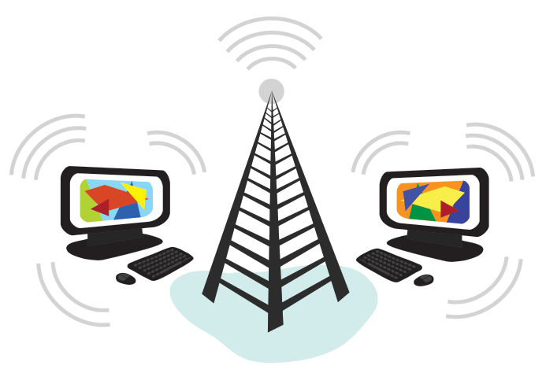
What is the internet?
The difference between the internet and the World Wide Web

Slide 3
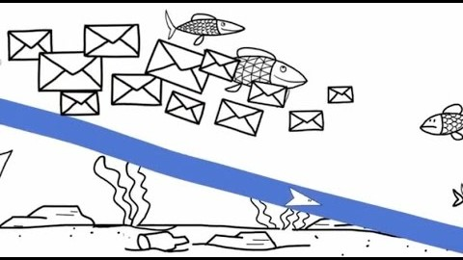
The Internet

Slide 4
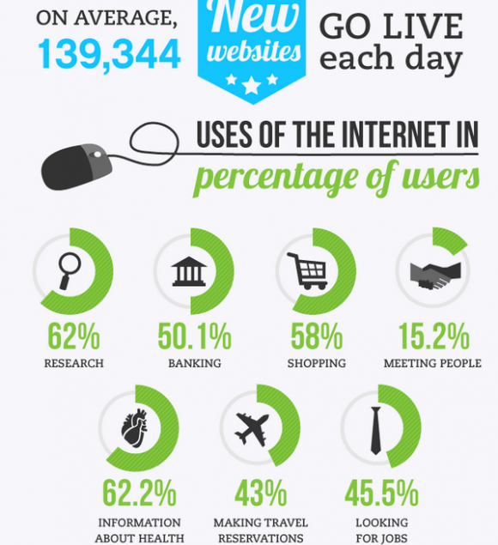
World Wide Web
USES:
Browsing
Web Apps
Cloud Apps
Email
Streaming Music and Video
Academic Activities
Notes:
*Web Browsing
*Web Apps like MS Word and Google Docs-they should be able to work without a constant web connection
*Cloud Apps that require a web connection for any use, Gmail, storage
*Academic Activities like this

Slide 5
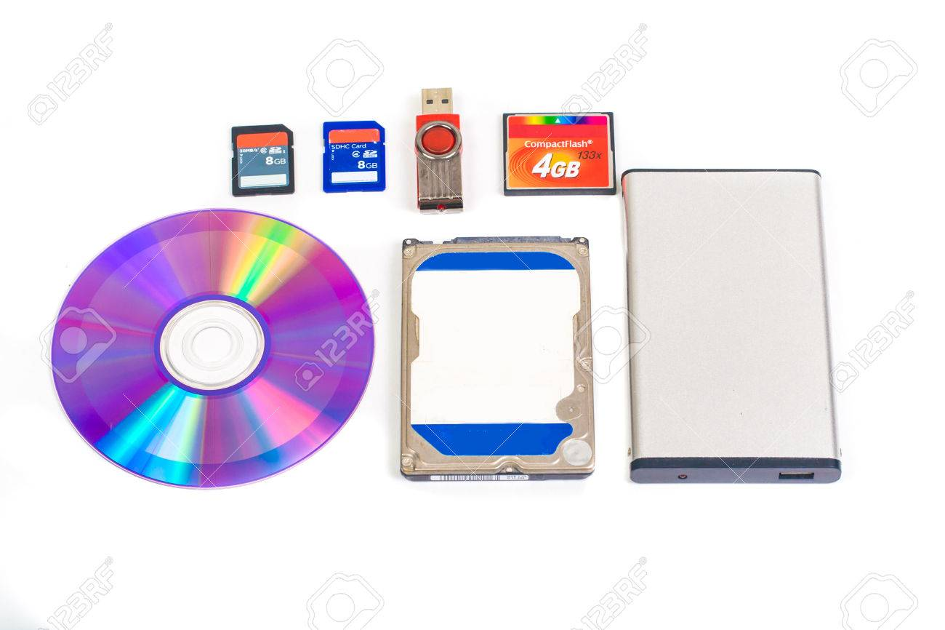
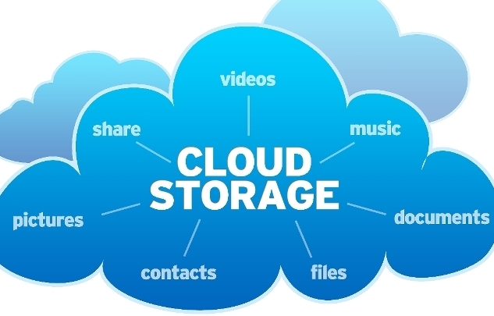
Step Back: Storage
Storage refers to where you, the user, save/store your data physically. (Using magnets and lasers or electricity)
There are THREE main forms of storage.
1.) Internal Storage (Hard Drive C: Drive)
2.)External Storage (Flash Drives, External Hard Drives) →To a lesser extent Discs and mini flash discs (etc.)
3.)Cloud Storage →Use someone else's computer to store your stuff!

Slide 6


“The Cloud”
Cloud storage is just storing your stuff on someone else's computer.
Cloud apps are just using someone else's computer to do the work.

Slide 7
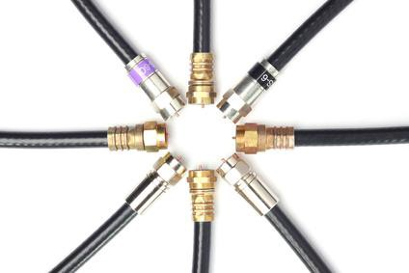
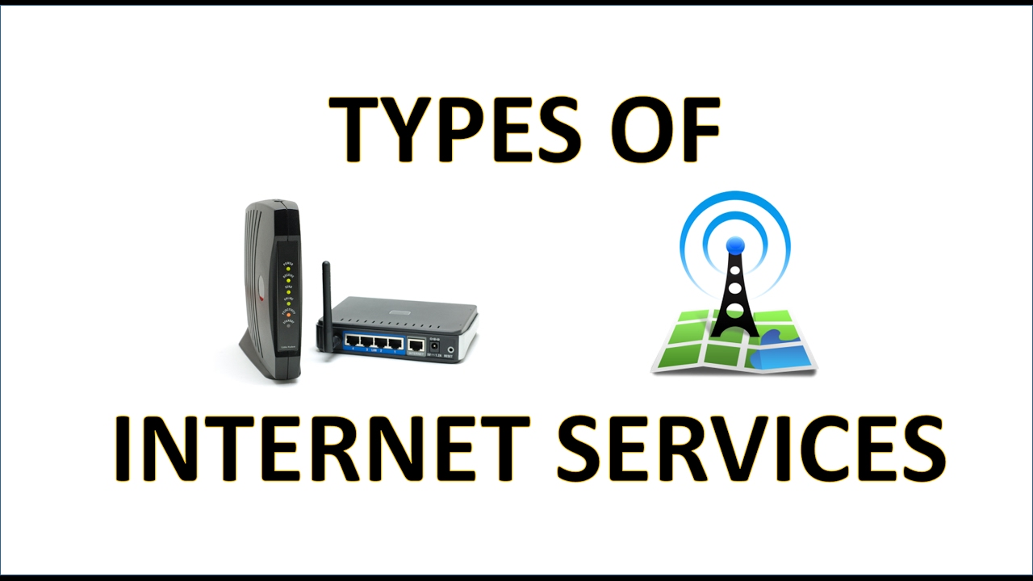
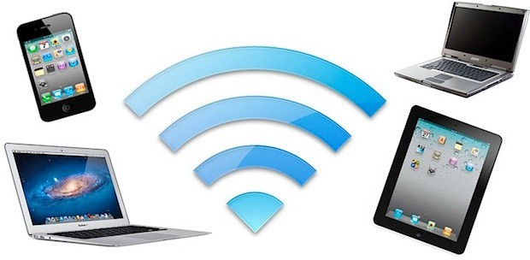
Back Online: Ways to connect
Broadband (Cable/DSL)
Wi-Fi
Cellular Data

Slide 8
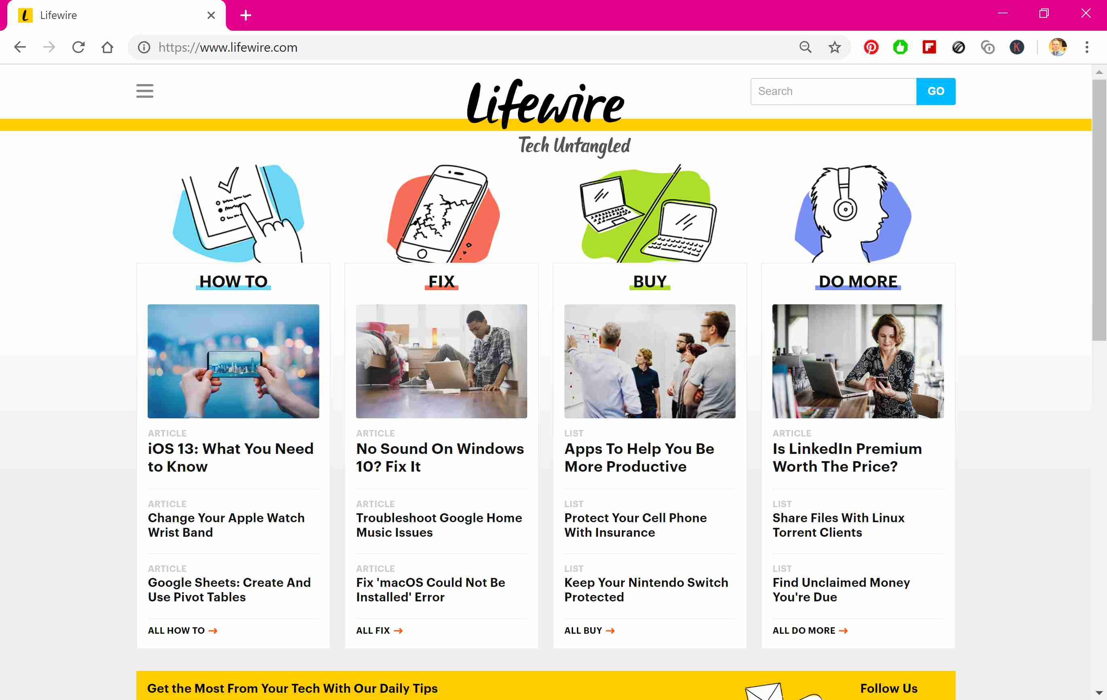

Browsing with…
-Edge
-Firefox
-Safari
-Chrome

Slide 9

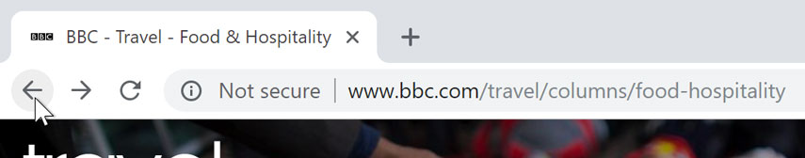
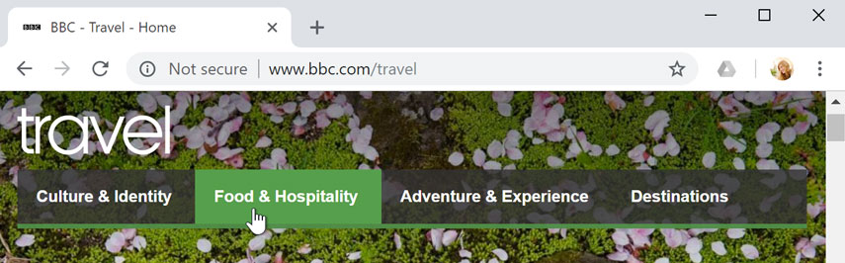
Browser Basics
-Common Browser Functions
URL/Address Bar
Back/Forward and refresh
Hand Icon Means a Link

Slide 10
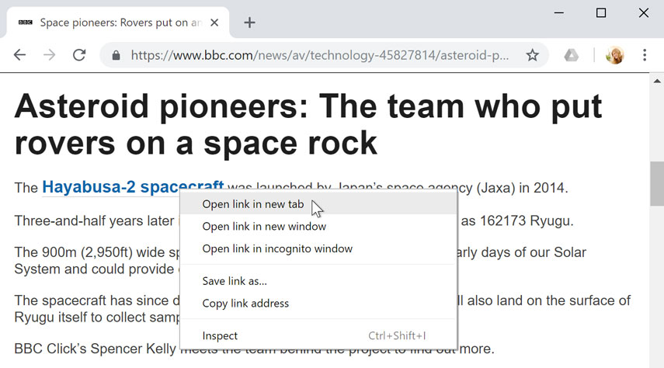


Tabs
Open links in a new tab
Close and Create new tabs
Combine with searches!

Slide 11

Security Concerns
HTTP = UNSECURE!
HTTPS = SECURE
Only provide information to a secure site!!

Slide 12
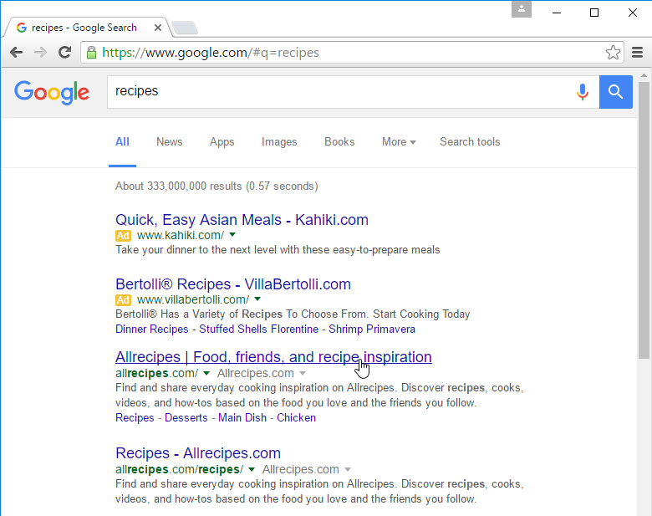
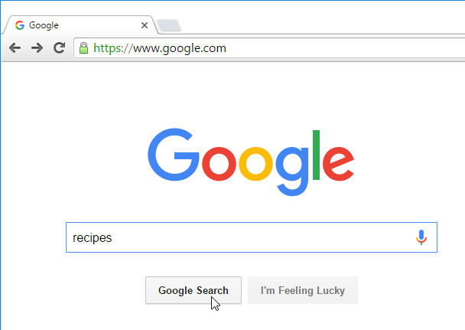
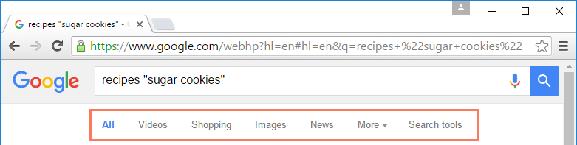
Search Engines

Slide 13
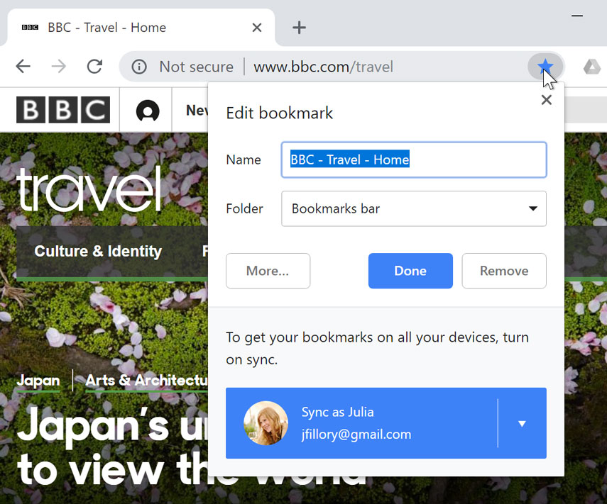
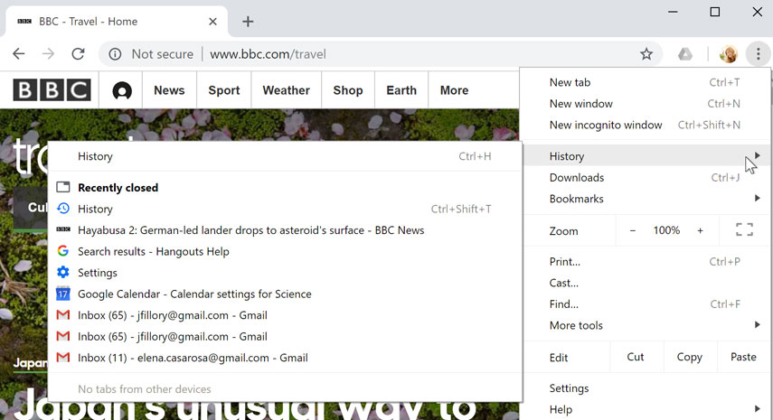
Browser misc.
*Bookmarking *History *Zoom *Find *New Incognito Window

Slide 14
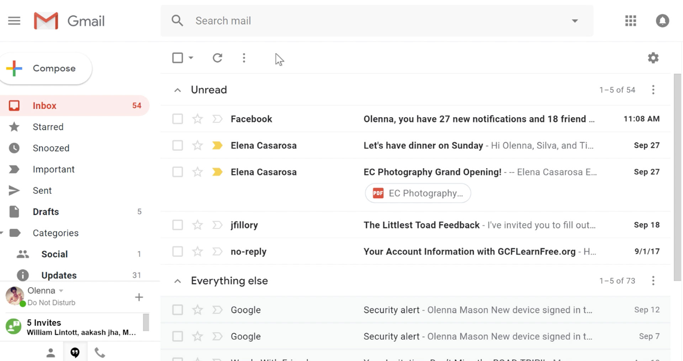
Gmail Basics

Slide 15
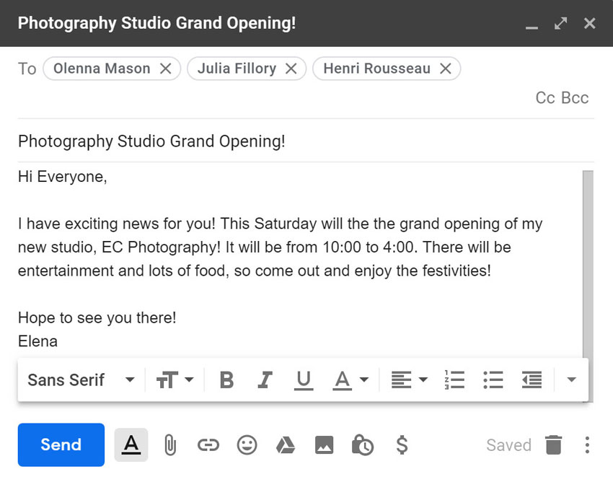
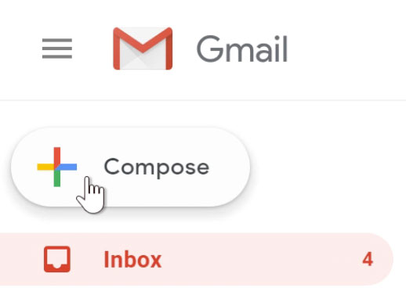
Sending Mail

Slide 16
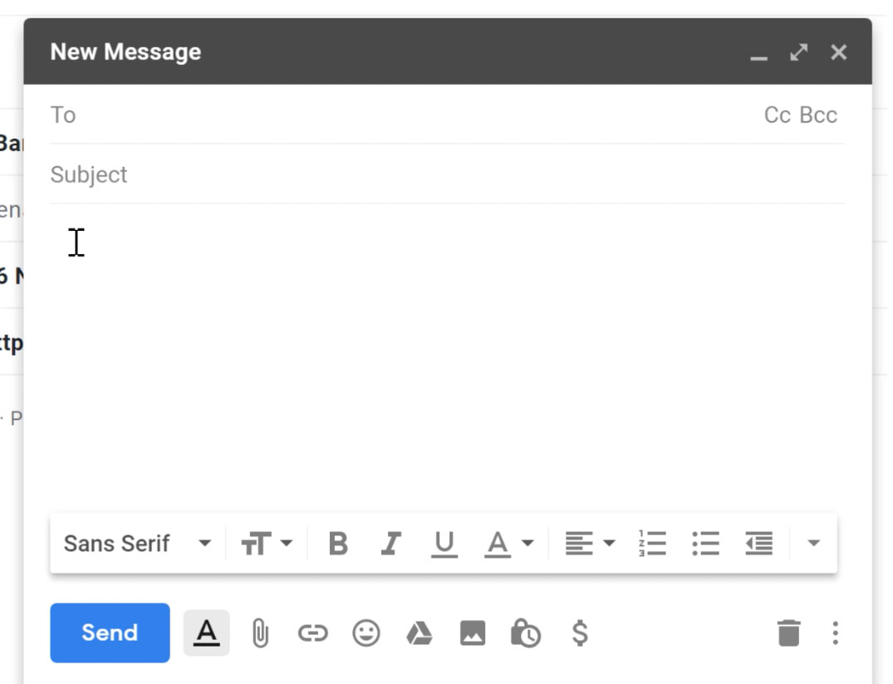
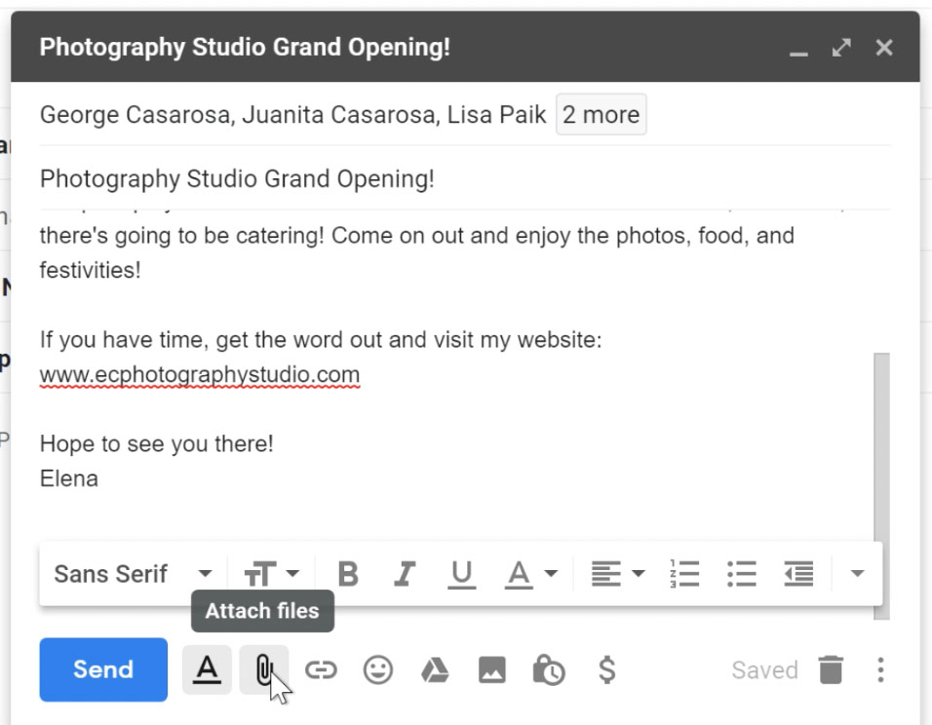
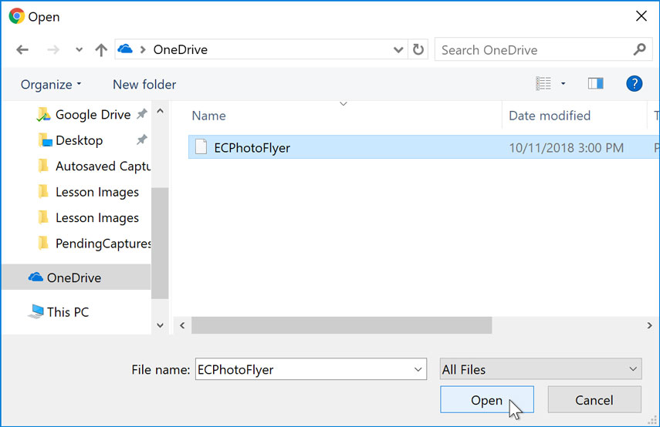
Sending Attachments
Find and click the paperclip icon
Use the open dialogue box to add files

Slide 17
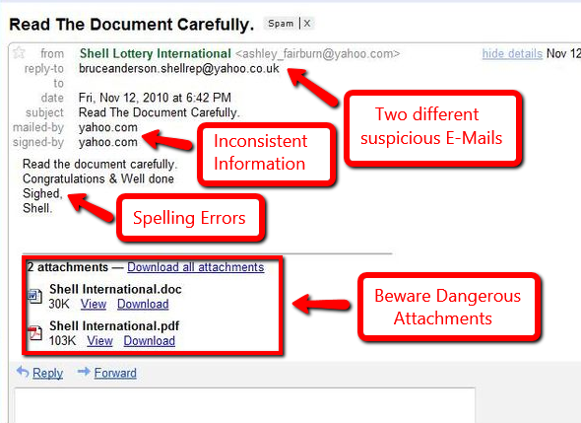
Evaluate Email
Phishing scams are used to gain information from simple information to sensitive passwords.
Never open an attachment unless you trust the sender
Never use a link inside an email you don’t trust. Try not to if you can manage.

Slide 18
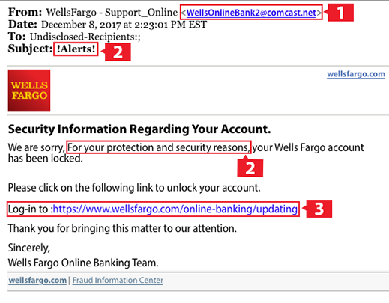
Don’t let logo’s throw you off
Wrong email domain
Scare tactics’
Fake Link!

